Slide 1
Carbon Reduction through Building Electrification – Part 1: All-Electric Design and Construction Series
Jennifer Rennick, AIA, CEA – In Balance Green Consulting
Andy Pease, AIA, LEED AP BD+C – In Balance Green Consulting
December 19, 2024
Notes:
[PRESS RECORD]

Slide 2
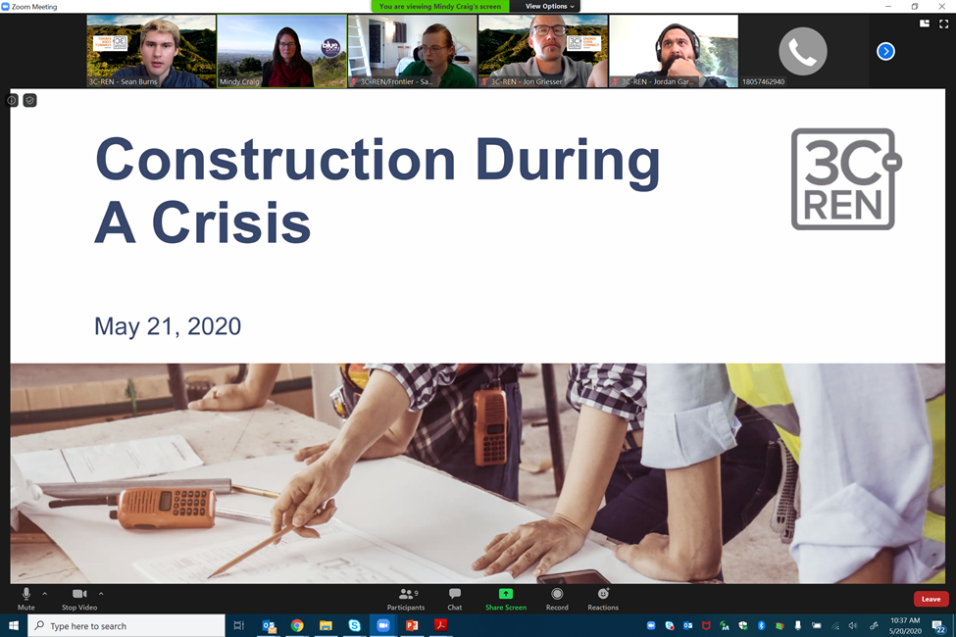
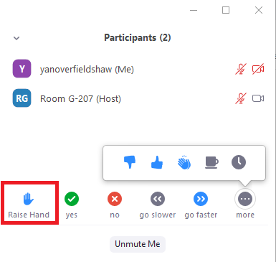
Zoom Orientation
Please be sure your full name is displayed
Please mute upon joining
Use "Chat“ box to share questions or comments
Under "Participant" select "Raise Hand"
to share a question or comment verbally
The session may be recorded and posted to 3C-REN's on-demand page. Feel free to ask questions via the chat and keep video off if you want to remain anonymous in the recording.
Notes:
we ask that everyone make sure they are on mute throughout the duration of the course. If you would like to verbally participate, please raise your hand in the participant's section and we will call on you to unmute yourself.
We encourage you to participate and ask questions through the chat box as well

Slide 3
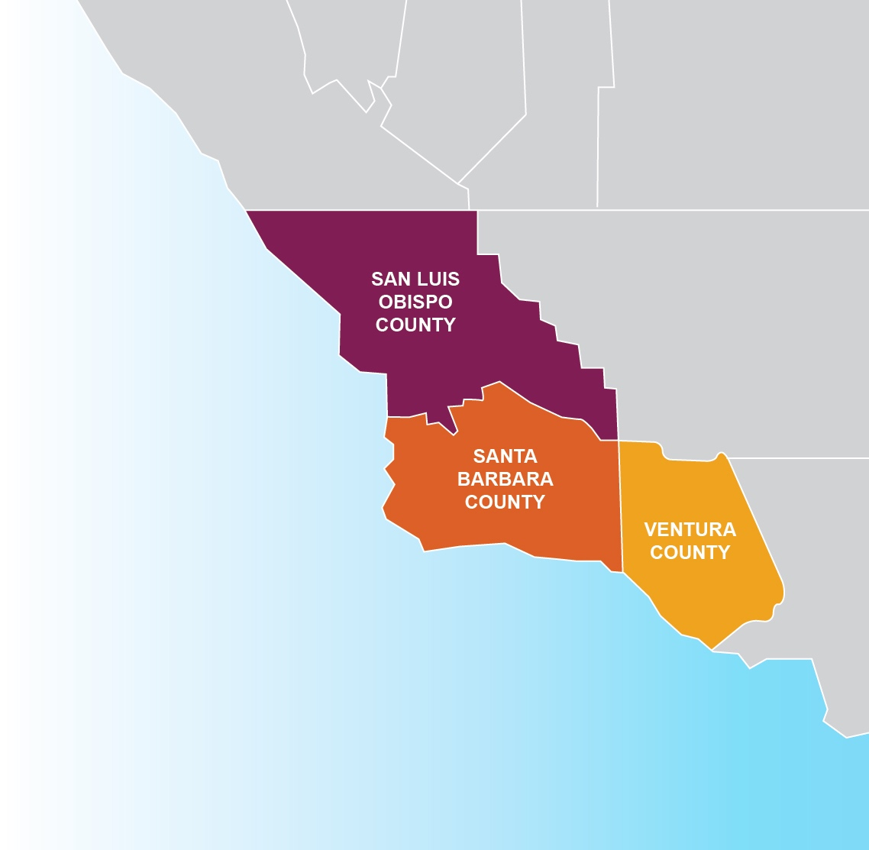
3C-REN: Tri-County
Regional Energy Network
  Three counties working together to improve energy efficiency in the region
  Services for –
    Building Professionals: industry events, training, and energy code compliance support
    Households: free and discounted home upgrades
  Funded by ratepayer dollars that 3C-REN returns to the region
Notes:
A little bit about 3C-REN
We are a collaborative partnership between San Luis Obispo, Santa Barbara and Ventura Counties
Working to improve energy efficiency in our region by offering free programs and services for building professionals and households
3C-REN is funded by ratepayer dollars which are collected through the Public Goods Charge found on our utility bills.
The benefit of being ratepayer funded is that there is no cost to those we serve
And we are able to return these dollars back to our local economy which has historically missed out on some of these funds.
We currently offer 3 programs

Slide 4
3C-REN Programs
Energy Code Connect (ECC)
  Industry Trainings and Regional Forums
  Energy Code Coach: Title 24 Compliance Support Hotline (805) 220-9991
Building Performance Training (BPT)
  Industry Trainings & Certification for current and perspective building professionals
  Helps workers thrive in an evolving industry
Home Energy Savings (HES)
  Flexible Home Energy Upgrades
  Multifamily (5+ units) & Single Family (up to 4 units)
Notes:
Energy Code Connect
Where we offer Industry Trainings, Regional Forums, and a Title 24 consultation service called Energy Code Coach to help building professionals navigate the CA Energy Code and Green Building Requirements.
The phone number listed on the slide is our Energy Code Coach Hotline and there’s also an inquiry form on our website.
Building Performance Training
We offer trainings on technical and soft skills related to building science principles and systems for high performance building.
Our goal is to bring industry recognized Certifications and Training Providers to the Central Coast that will help advance people wherever they may be at in their career.
Home Energy Savings​​
Which serves households that are historically underserved with free and discounted home energy upgrades.​​
If you or any of your clients are looking to make energy efficiency or electrification upgrades please check out our website to find an enrolled contractor
And if you are a contractor interested in participating, please reach out or fill out an inquiry form on our website 3C-REN.org​

Slide 5


California
Licensure &
AIA Learning Units
Beginning in 2023 Licensed Architects are required by the State of California to take five (5) hours of Continuing Education (CE) coursework in Zero Net Carbon Design (ZNCD).
This course is designed to count towards CA’s ZNCD requirement as well as AIA’s Health, Safety, Welfare (HSW) Learning Units.
The whole series provides 5 AIA HSW / CA ZNCD Learning Units
For more information see https://www.cab.ca.gov/docs/misc/ab1010_zncdce_faq.pdf

Slide 6
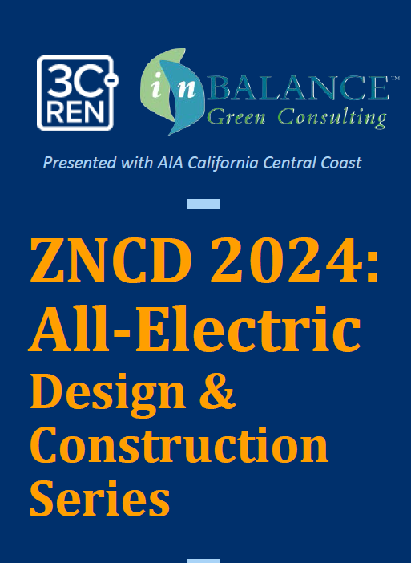
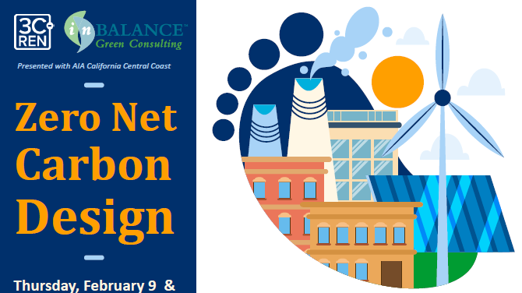
Series Outline
Overview: Carbon Reduction through Building Electrification
ZNCD for Heat Pumps for heating and cooling
ZNCD for Domestic Hot Water
ZNCD for Ventilation and HRV
ZNCD for Appliances & Energy Storage

Slide 7
Today’s Learning Objectives
Learn the ‘why’ behind California’s shift to building electrification and the link to Zero Net Carbon Design
Learn the pros and cons of various products to help in selecting appropriate systems that meet electrification and carbon-reduction goals
Learn critical installation details such as dimensions and venting to call out in plans and/or identify early in construction
Understand the local market for specific all-electric/ZNCD equipment, including cost, availability and lead times.
Learning Units:
1.0 AIA HSW LU approved for this course
We’ll send you the slides later!

Slide 8

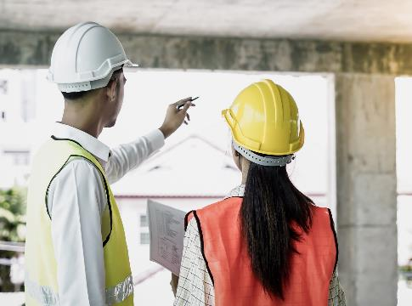
Agenda
California’s Clean Energy Goals
ZNCD and the Electric Grid
ZNCD and Transportation
ZNCD Buildings

Slide 9
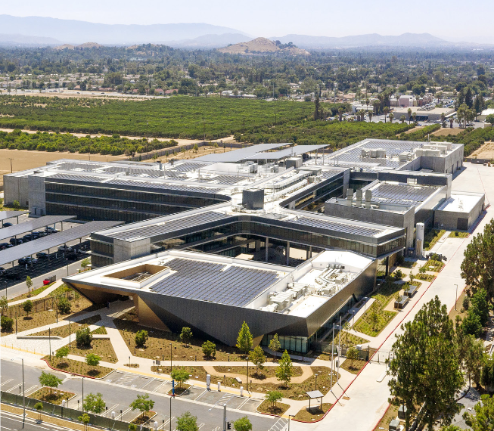
ZNCD and California’s Clean Energy Goals
California Air Resources Board (CARB) - Mary D. Nichols Campus

Slide 10
Vocabulary Review
ZNCD –Zero Net Carbon Design
Operational Carbon
  CO2e emissions related to building energy use
Embodied Carbon
  CO2e emissions related to building materials and construction
Global Warming Potential (GWP)
  Metric Using Carbon Dioxide Equivalent (CO2e) as Baseline of 1
  Common Metric for Refrigerants
Decarbonization
  Elimination of CO2e emissions as a method of mitigating climate change
Fossil Fuels
  Oil, Gasoline, Diesel, Natural Gas, Propane, etc.
‘Non-Combustion’ or High-GWP
  Methane
  Refrigerants
Green House Gases (GHG):
  CO2 – Carbon Dioxide
  CH4 – Methane
  N2O – Nitrous Oxide
  HFCs – Hydrofluorocarbons
  PFCs – Perfluorocarbons
  SF6 – Sulfur Hexafluoride
  NF3 – Nitrogen Trifluoride
Clean Energy / Electricity
  Energy Produced without Emissions
Clean Fuel
  Hydrogen (H2) Fuel Cells
NOAA – National Oceanic and Atmospheric Administration
DOE – Department of Energy
EIA – Energy Information Administration
CARB – California Air Resources Board
CEC – California Energy Commission
CAISO –California Independent Systems Operator

Slide 11










People, Buildings and Everything
Operational and Embodied Impacts
Electricity
Natural Gas
Refrigerants
Building Materials and Manufacturing
Water Energy Nexus
Pumping
Cleaning
Water
Shelter
Agriculture and Forestry
Harvesting
Processing
Transporting
Buildings
Food
People and Goods
Personal Vehicles
Trucking
Shipping
All Energy Types
Gas, Diesel
Natural Gas
Nuclear
Solar & Wind
Hydroelectric
Transportation
Energy

Slide 12

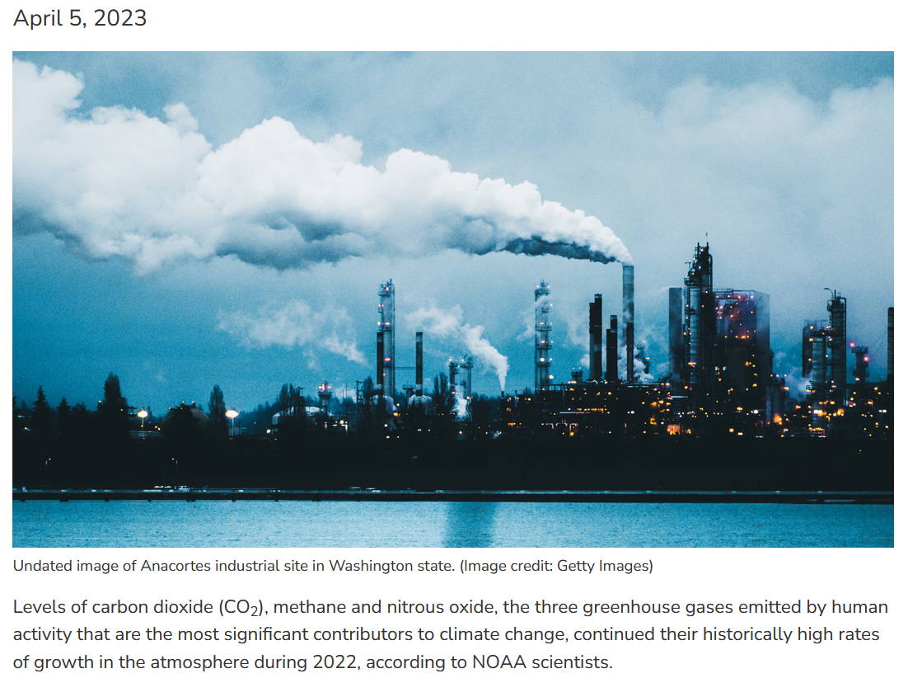
The Source of Our Energy Impacts Climate Change
Burning of Fossil Fuels is the Main Driver of CO2 Emissions
CO2 Emissions is the largest contributor to Climate Change
Burning of Fossil Fuels is used for
  Transportation
  Industrial Processes
  Electricity Generation
  Equipment for Agriculture & Forestry
  Space Heating – Commercial and Residential
  Water Heating – Commercial and Residential
https://www.noaa.gov/news-release/greenhouse-gases-continued-to-increase-rapidly-in-2022

Slide 13

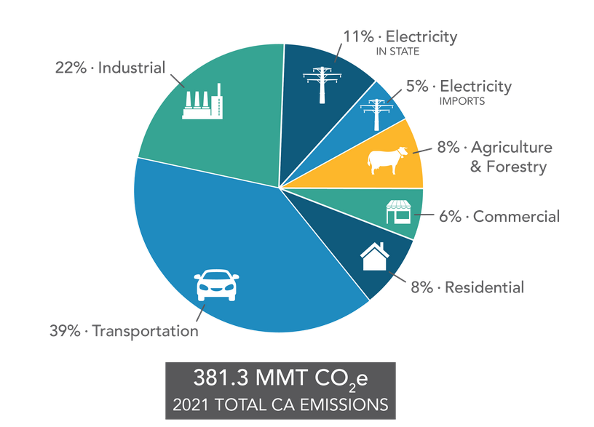
California GHG Emissions by Main Economic Sector
California has identified the primary sectors responsible for the majority of GHG Emissions
Transportation is at the top
https://ww2.arb.ca.gov/ghg-inventory-data

Slide 14
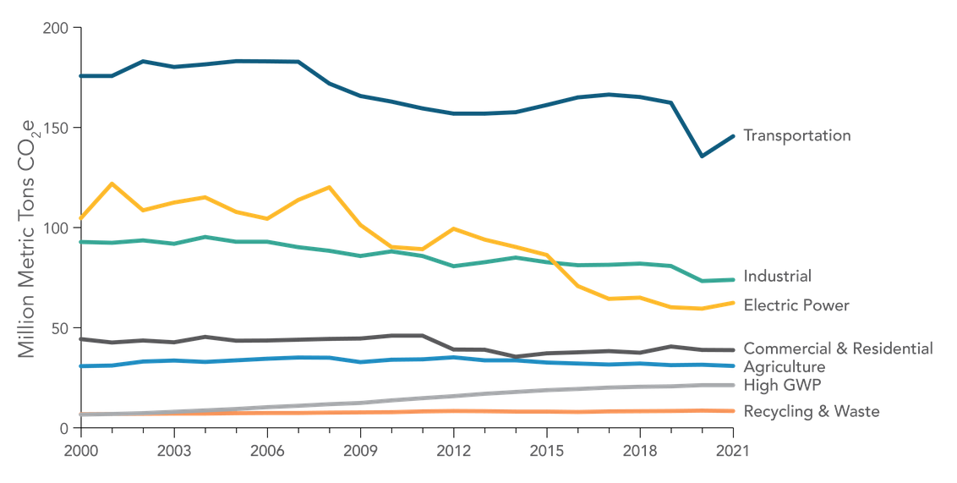




California GHG Emissions Trends
Transportation, Industrial, and Electric Power GHG Emissions have decreased even as California’s population grow.
High GWP (refrigerants) increased during the same time period.
https://ww2.arb.ca.gov/ghg-inventory-data

Slide 15
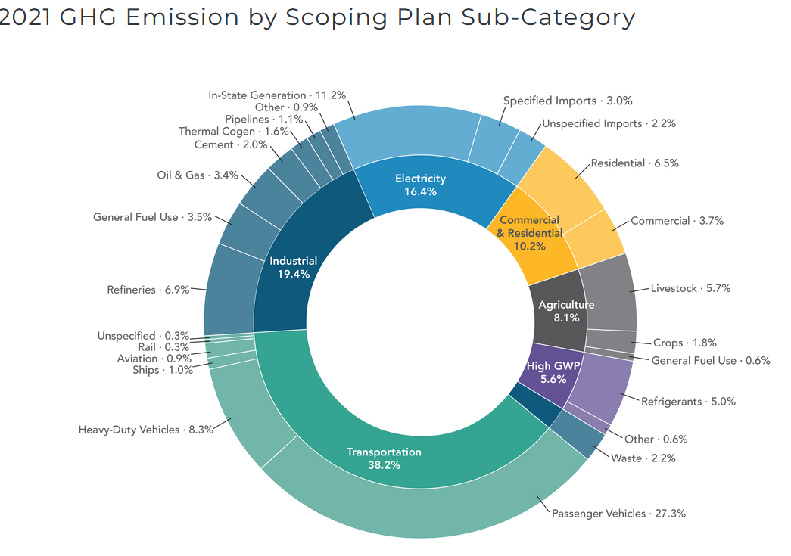









Buildings and Construction GHG Emissions Cut Across Sectors
‘Buildings and Construction’ account for approx 25% of GHG Emissions in California
The impact is likely much larger due to the emissions of materials manufactured out of state
Project 2030 estimates Buildings account for 42% of global GHG emissions
https://ww2.arb.ca.gov/ghg-inventory-data
Notes:
Building Professionals, including architects, planners, policy makers, engineers, builders, and manufactures, etc., will have a profound influence on the implementation of California’s Decarbonization Goals

Slide 16
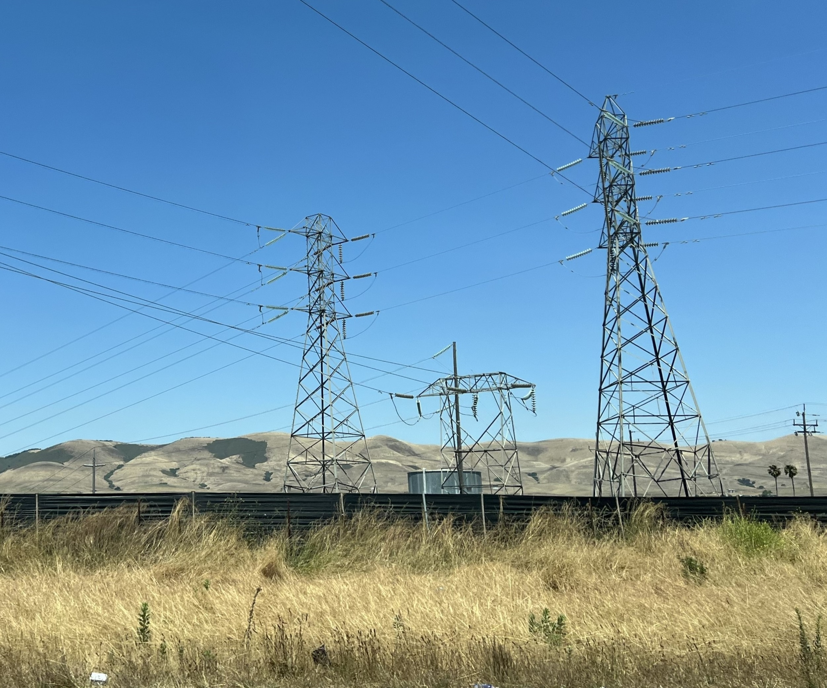
ZNCD and The Electric Grid

Slide 17
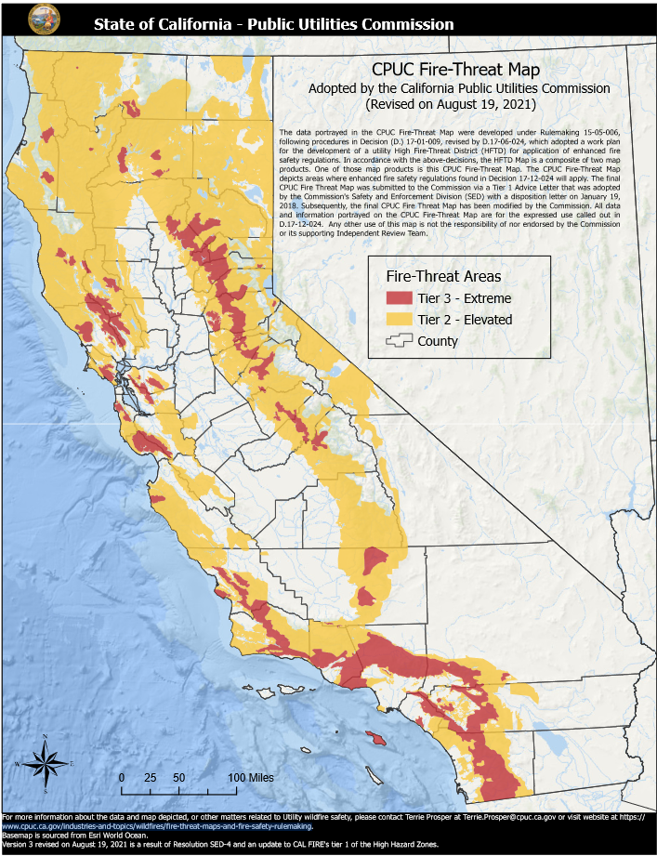
Key Concepts for ZNCD and our Electric Grid
Reliability – is the power distribution and transmission steady and continuous
Adequacy – do we have enough resource capacity to meet demand
Resiliency – can we safely and efficiently power down and power off during Public Safety Power Shutoffs (PSPS) to prevent wild fire
Climate Action Goals – can we quickly implement zero-net-carbon electricity production
https://www.cpuc.ca.gov/industries-and-topics/wildfires

Slide 18
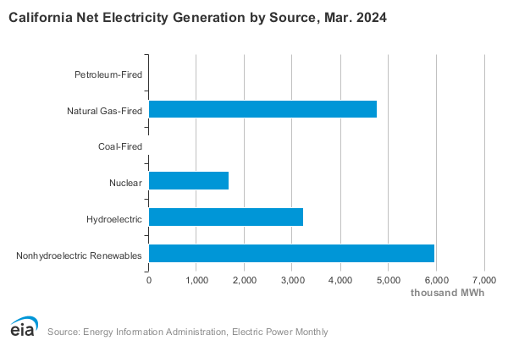
California’s Electricity Generation is Becoming Cleaner
Natural gas-fired fuel accounted for 31% of California’s electricity generation
Approx 69% came from non-fossil fuel sources
Nonhydroelectric Renewables (mostly wind and solar) provided approx 38% of the total mix
https://www.eia.gov/state/?sid=CA#tabs-4

Slide 19
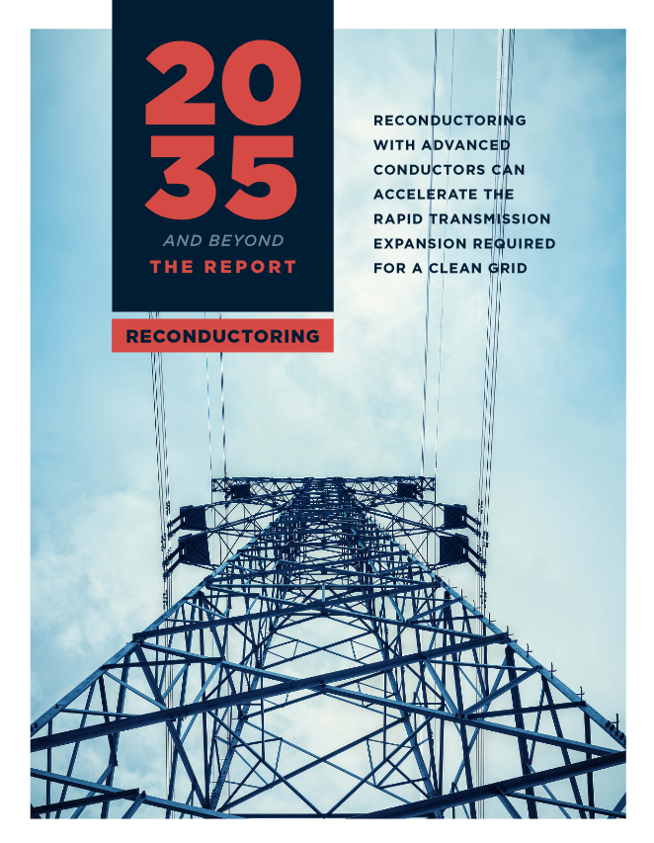
Strategies for Meeting the Increase in Energy Demand
Upgrades to the Grid –Improved wire types and transformers
Energy Storage Expansion –Short Duration and Long Term
Energy Resource Diversification
Natural Gas Substitutions –Hydrogen and Biomethane
This study specifically addresses upgrading the electric grid with new ‘advanced’ conductors without the need to build new lines in California.
https://www.2035report.com/wp-content/uploads/2024/04/GridLab_2035-Reconductoring-Technical-Report.pdf

Slide 20
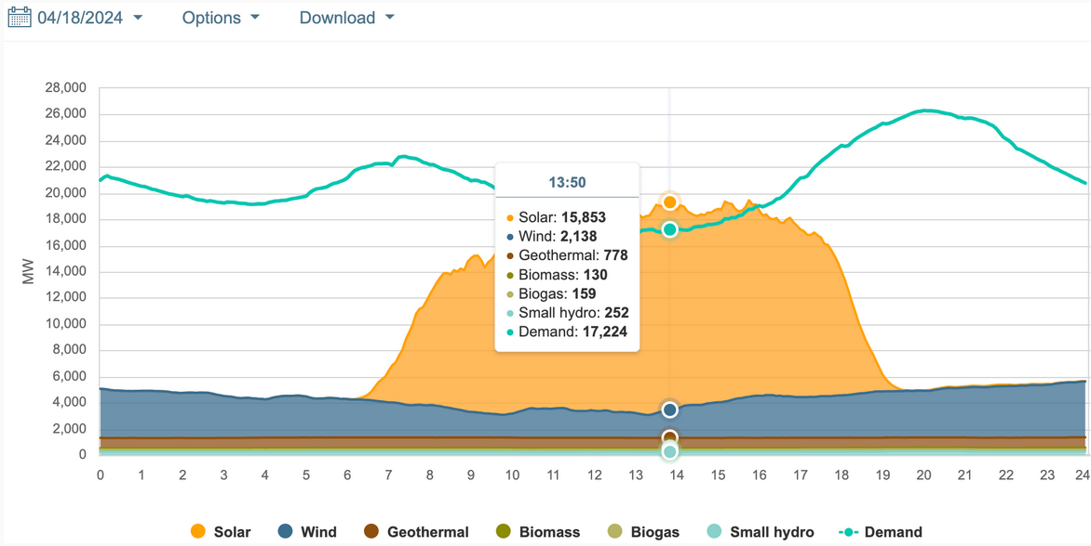
Solar Energy Exceeds Demand for Part of the Day
Area above the Green Line:
Solar Energy Exceeds Demand
White Areas: Demand is Met by Non-Renewables
https://www.gov.ca.gov/2024/04/19/californias-grid-keeps-setting-new-clean-energy-records/

Slide 21
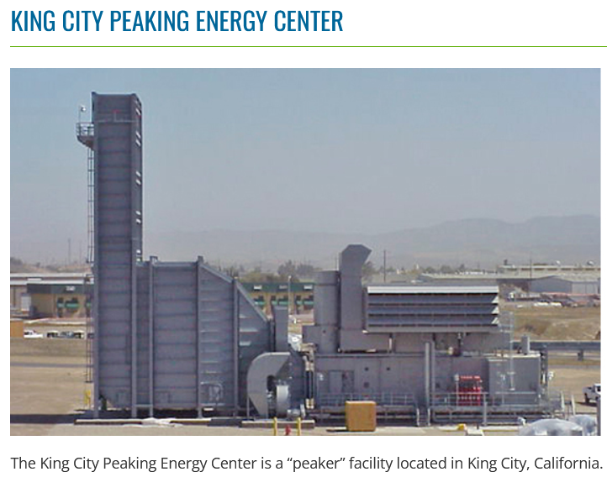
Present Situation: When Solar Cannot Meet Demand, NG Peaker Plants Kick-in
NG ‘Peaker’ Plants Provide Rapid Response Electricity
Peaker plants help meet peak electricity demand, typically during 4 pm-9 pm.
NG peaker plants provide energy when solar energy cannot meet demand
As we transition to a Clean Energy Grid, other technologies will be implemented to replace the heavy reliance on NG Peaker Plants.
https://www.calpine.com/King-City-Peaking-Energy-Center

Slide 22
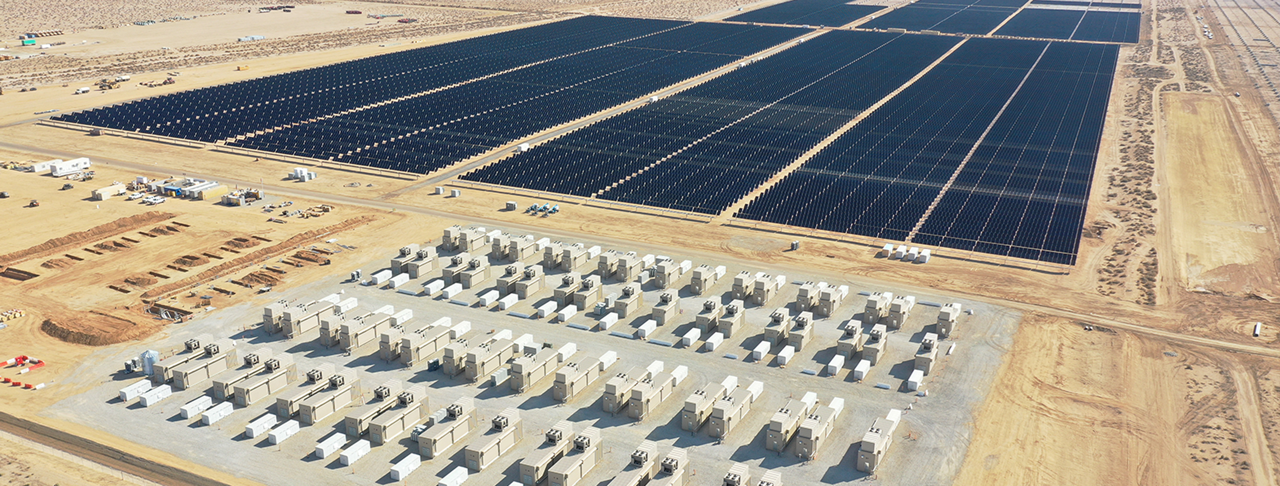
Alternative to Peaker Plants… Solar with Battery Storage
Located in California –Largest single Solar plus Battery Storge facility in the US.
Collaborative project with Edwards Air-Force Base.
Projected Completed Jan 2024.
Edwards & Sanborn Solar and Energy Storage, Kern County, CA
https://www.mortenson.com/projects/edwards-sanborn-solar-plus-storage

Slide 23
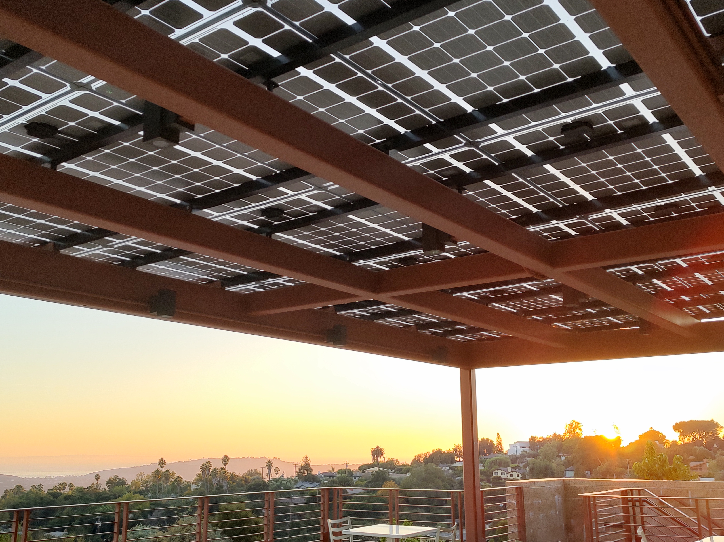
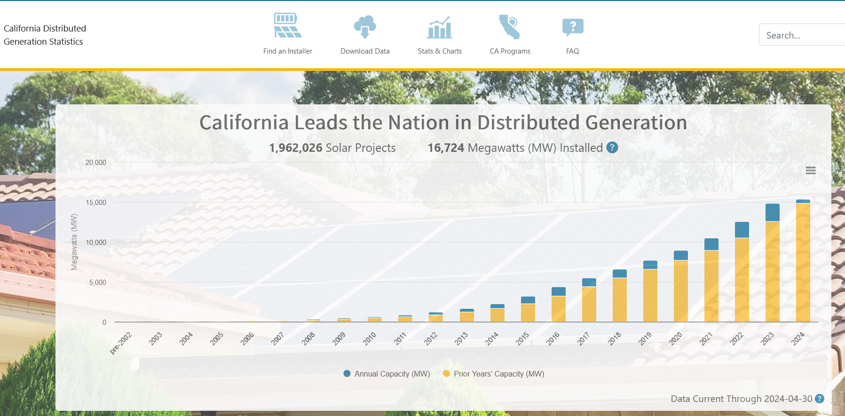
California Continues to Add Distributed and Grid Scale Solar
Cumulative growth in on-site (distributed) generation
https://www.californiadgstats.ca.gov/

Slide 24
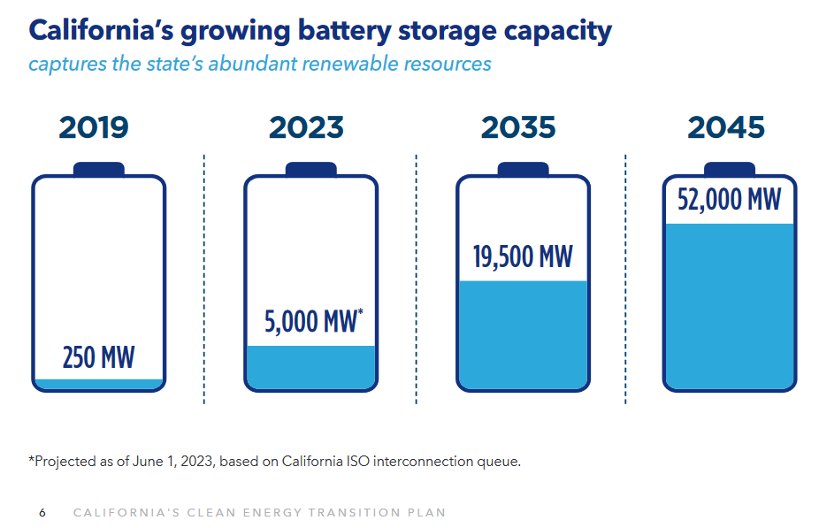
Solar and Battery Storage –Rapid Expansion Predicted
Excerpts from California’s Clean Energy Transition Plan for 2045:
https://www.gov.ca.gov/wp-content/uploads/2023/05/CAEnergyTransitionPlan.pdf

Slide 25
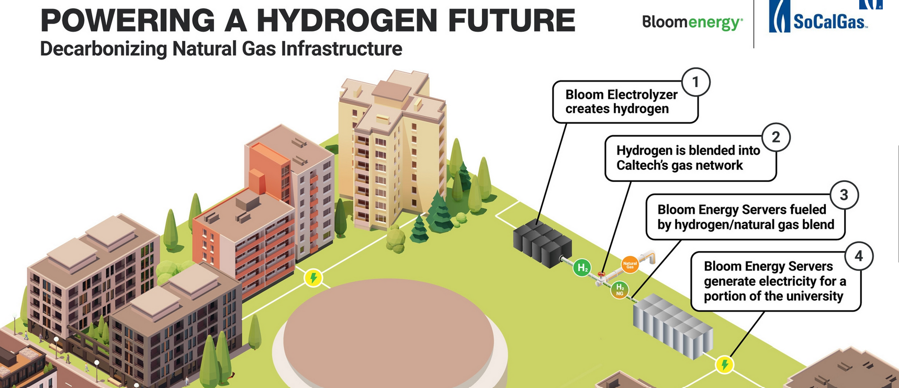
Other Infrastructure – Natural Gas and Hydrogen Blending
Mar 1, 2024 SoCalGas, SDG&E, Southwest Gas, and PG&E submitted joint proposal to California Public Utilities Commission (CPUC) for hydrogen blending projects
SoGalGas has shown successful pilot research at UC Irvine (2016);‘Real World’ Testing needed
Effort to reduce carbon in the existing NG infrastructure
Hydrogen would be created with excess solar energy that otherwise would be curtailed
Image from SoCalGas Newsroom: 2021 Demonstration Project Proposal with CalTech, Pasadena.

Slide 26
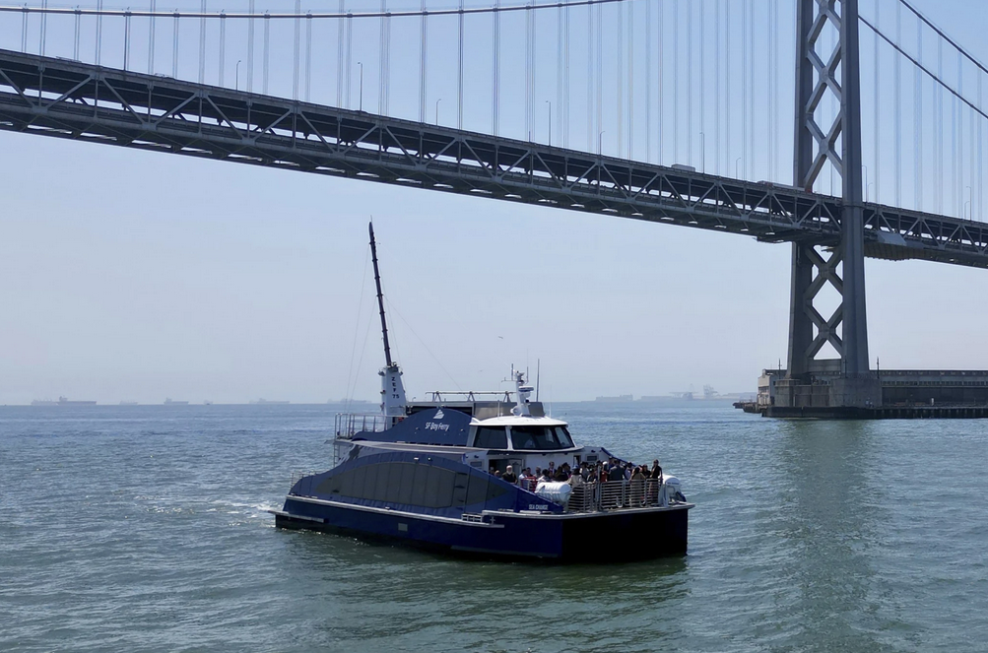
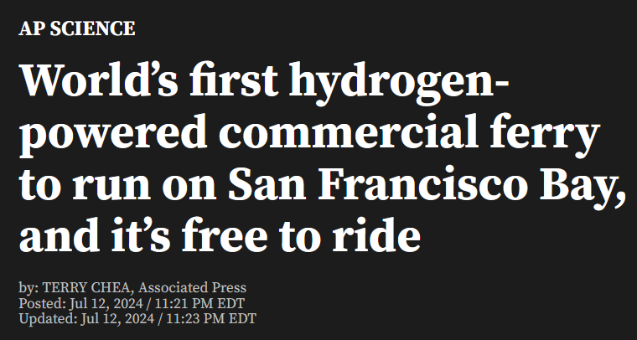
H2 Fuel Cells –Marine Vessels and Trucking Vehicles
Zero Emissions Industry (ZEI):
Received a $3 million grant from the California Air Resources Board (CARB)
Built the first hydrogen fuel cell passenger ferry in the United States
Proved that zero-emission hydrogen fuel cell technology works for commercial marine vessels
The Sea Change utilizes 360kw of H2 Fuel Cells and 100 kWh Li-Ion batteries
https://zeroei.com/sea-change

Slide 27
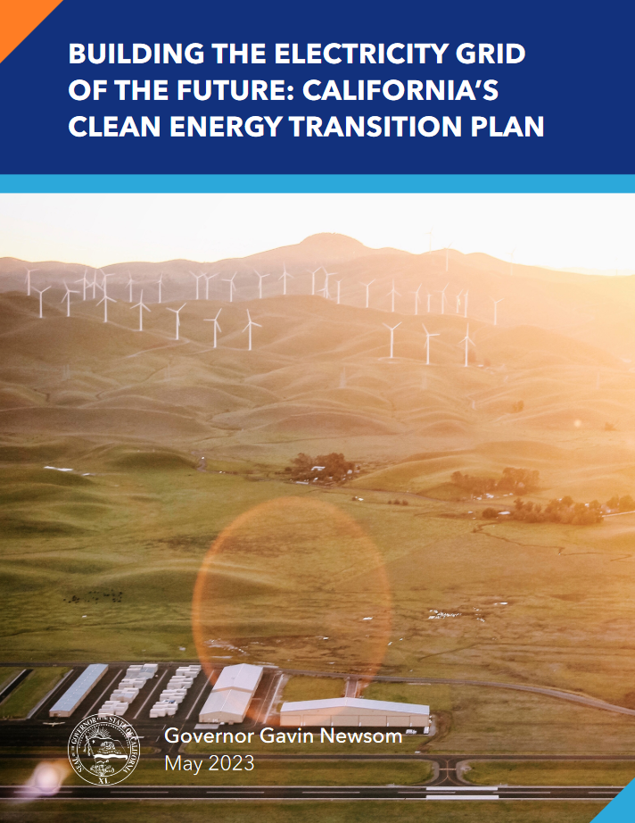
California’s Plan for Grid Stability and Expansion
A carbon-free electric grid where:
  Buildings are increasingly decarbonized.
  The Industrial Sector is powered by clean electricity, and by clean fuels, such as green hydrogen.
  Transportation choices are zero-emission and able to plug into the electric grid at places of convenience for all customers
https://www.gov.ca.gov/wp-content/uploads/2023/05/CAEnergyTransitionPlan.pdf

Slide 28
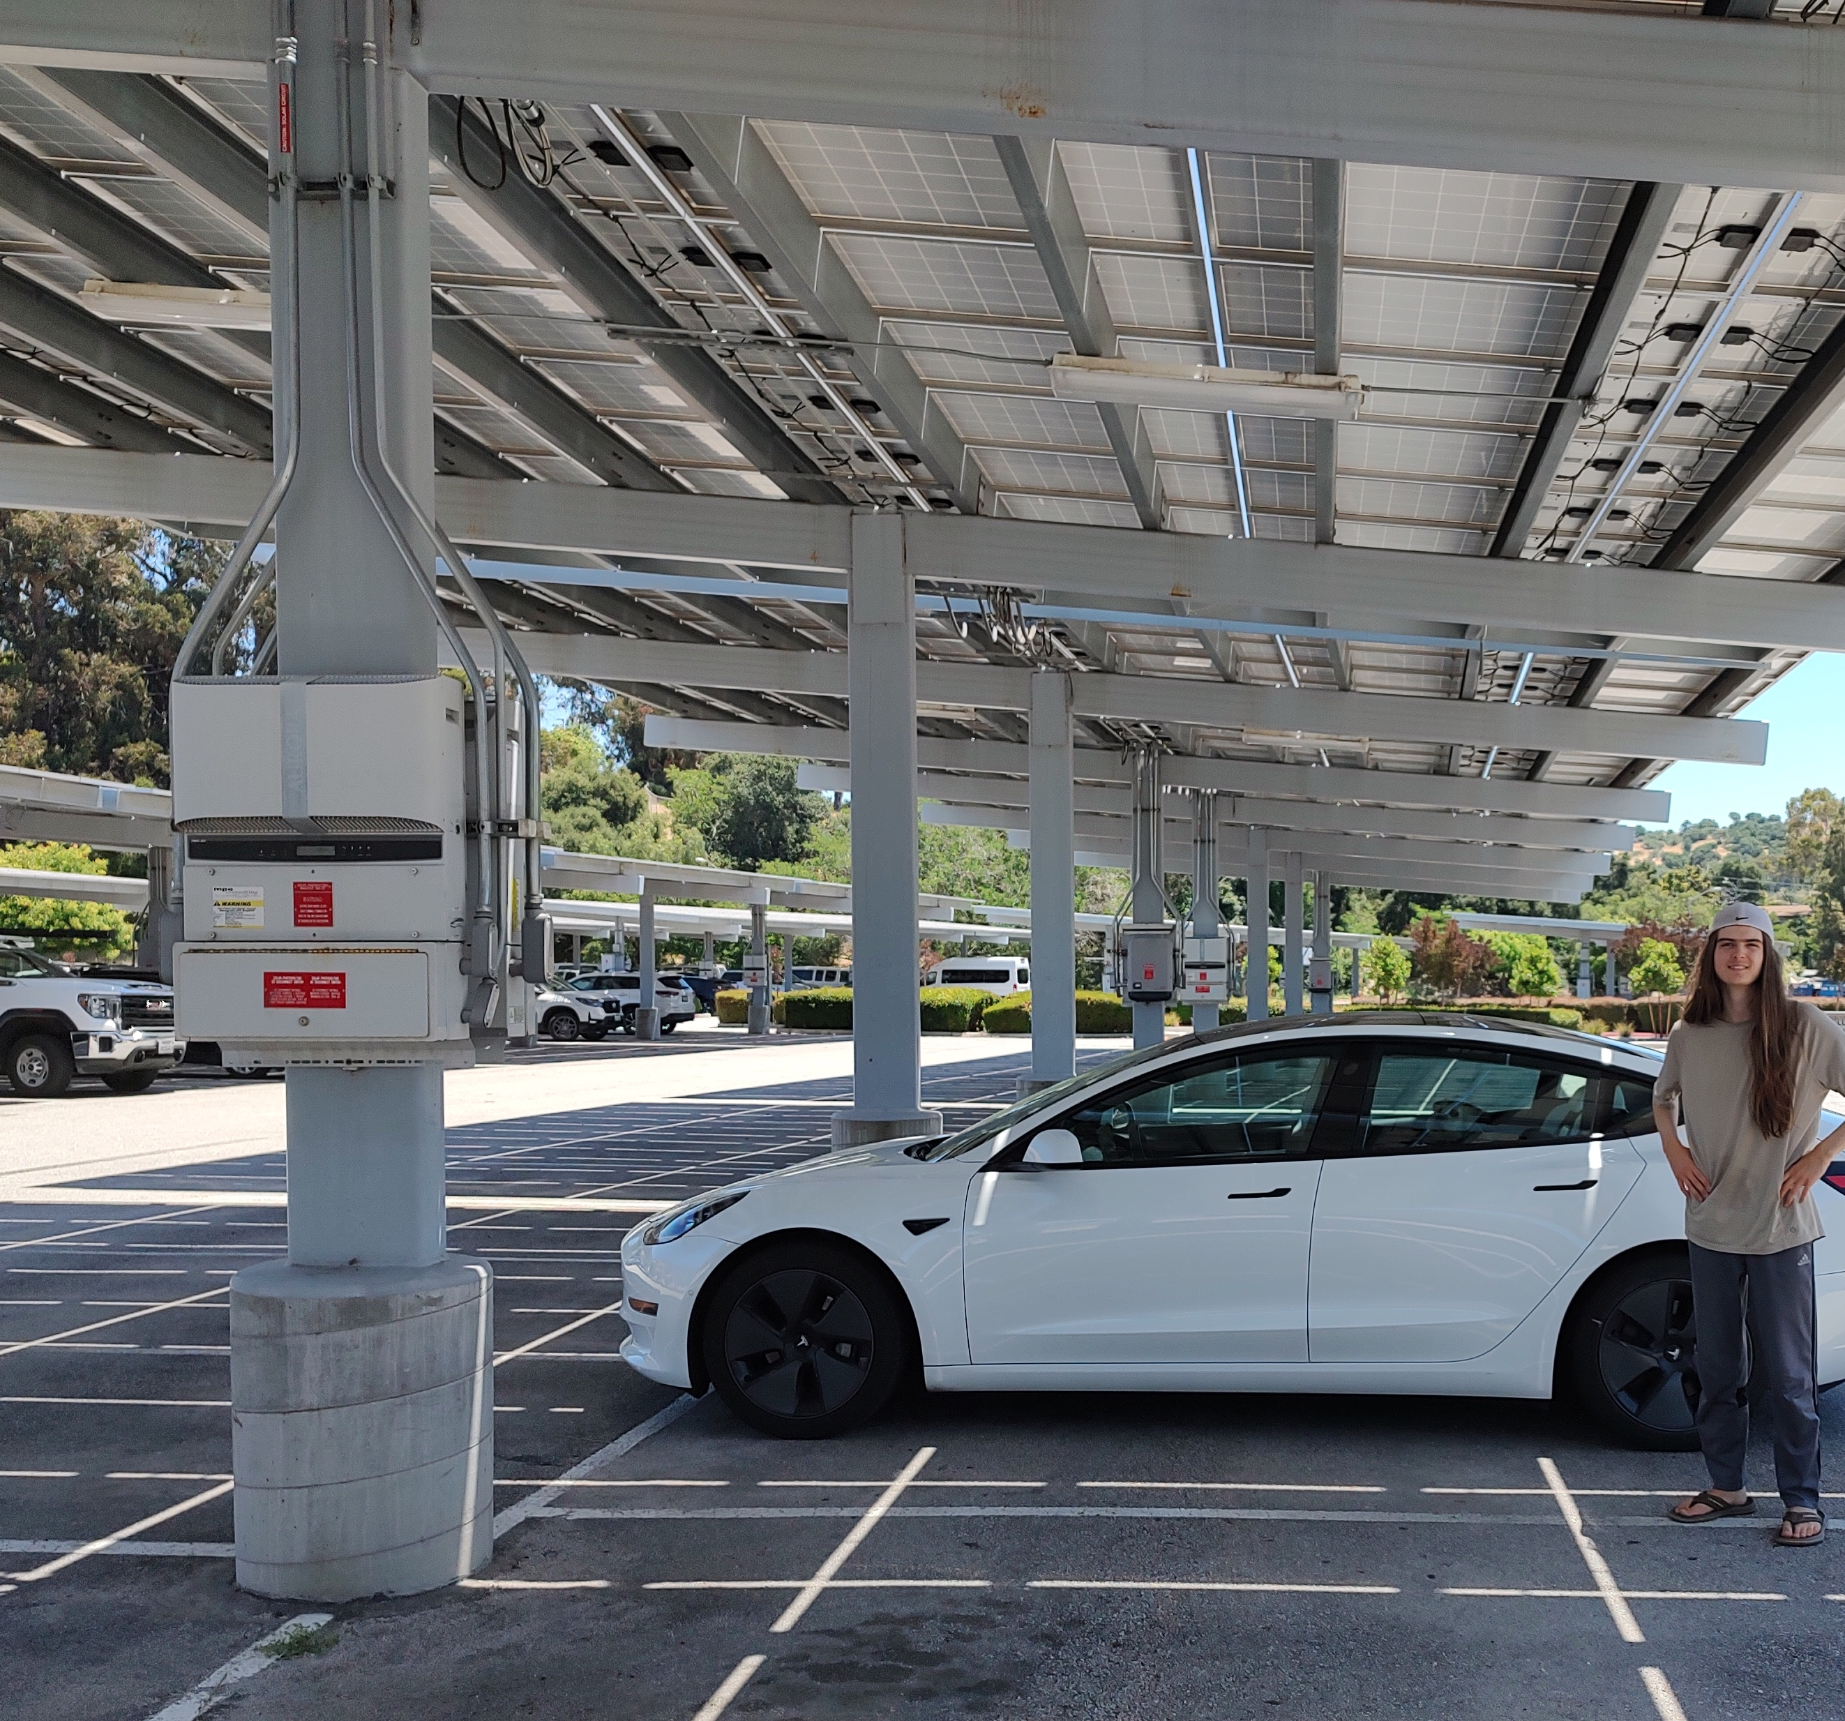
ZNCD and
Transportation

Slide 29
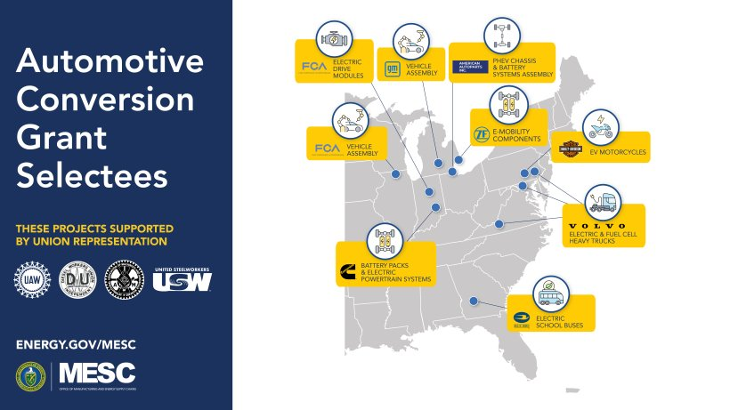
US Funds $1.7B for Electric Vehicle Manufacturing
DOE, Office of Manufacturing and Energy Supply Chains:
$1.7 billion from the Inflation Reduction Act (IRA)
Eleven (11) facilities will be converted to manufacture electric vehicles and their supply chain.
Facility Locations:
  Michigan
  Ohio
  Pennsylvania
  Georgia
  Illinois
  Indiana
  Maryland
  Virginia
https://www.energy.gov/mesc

Slide 30
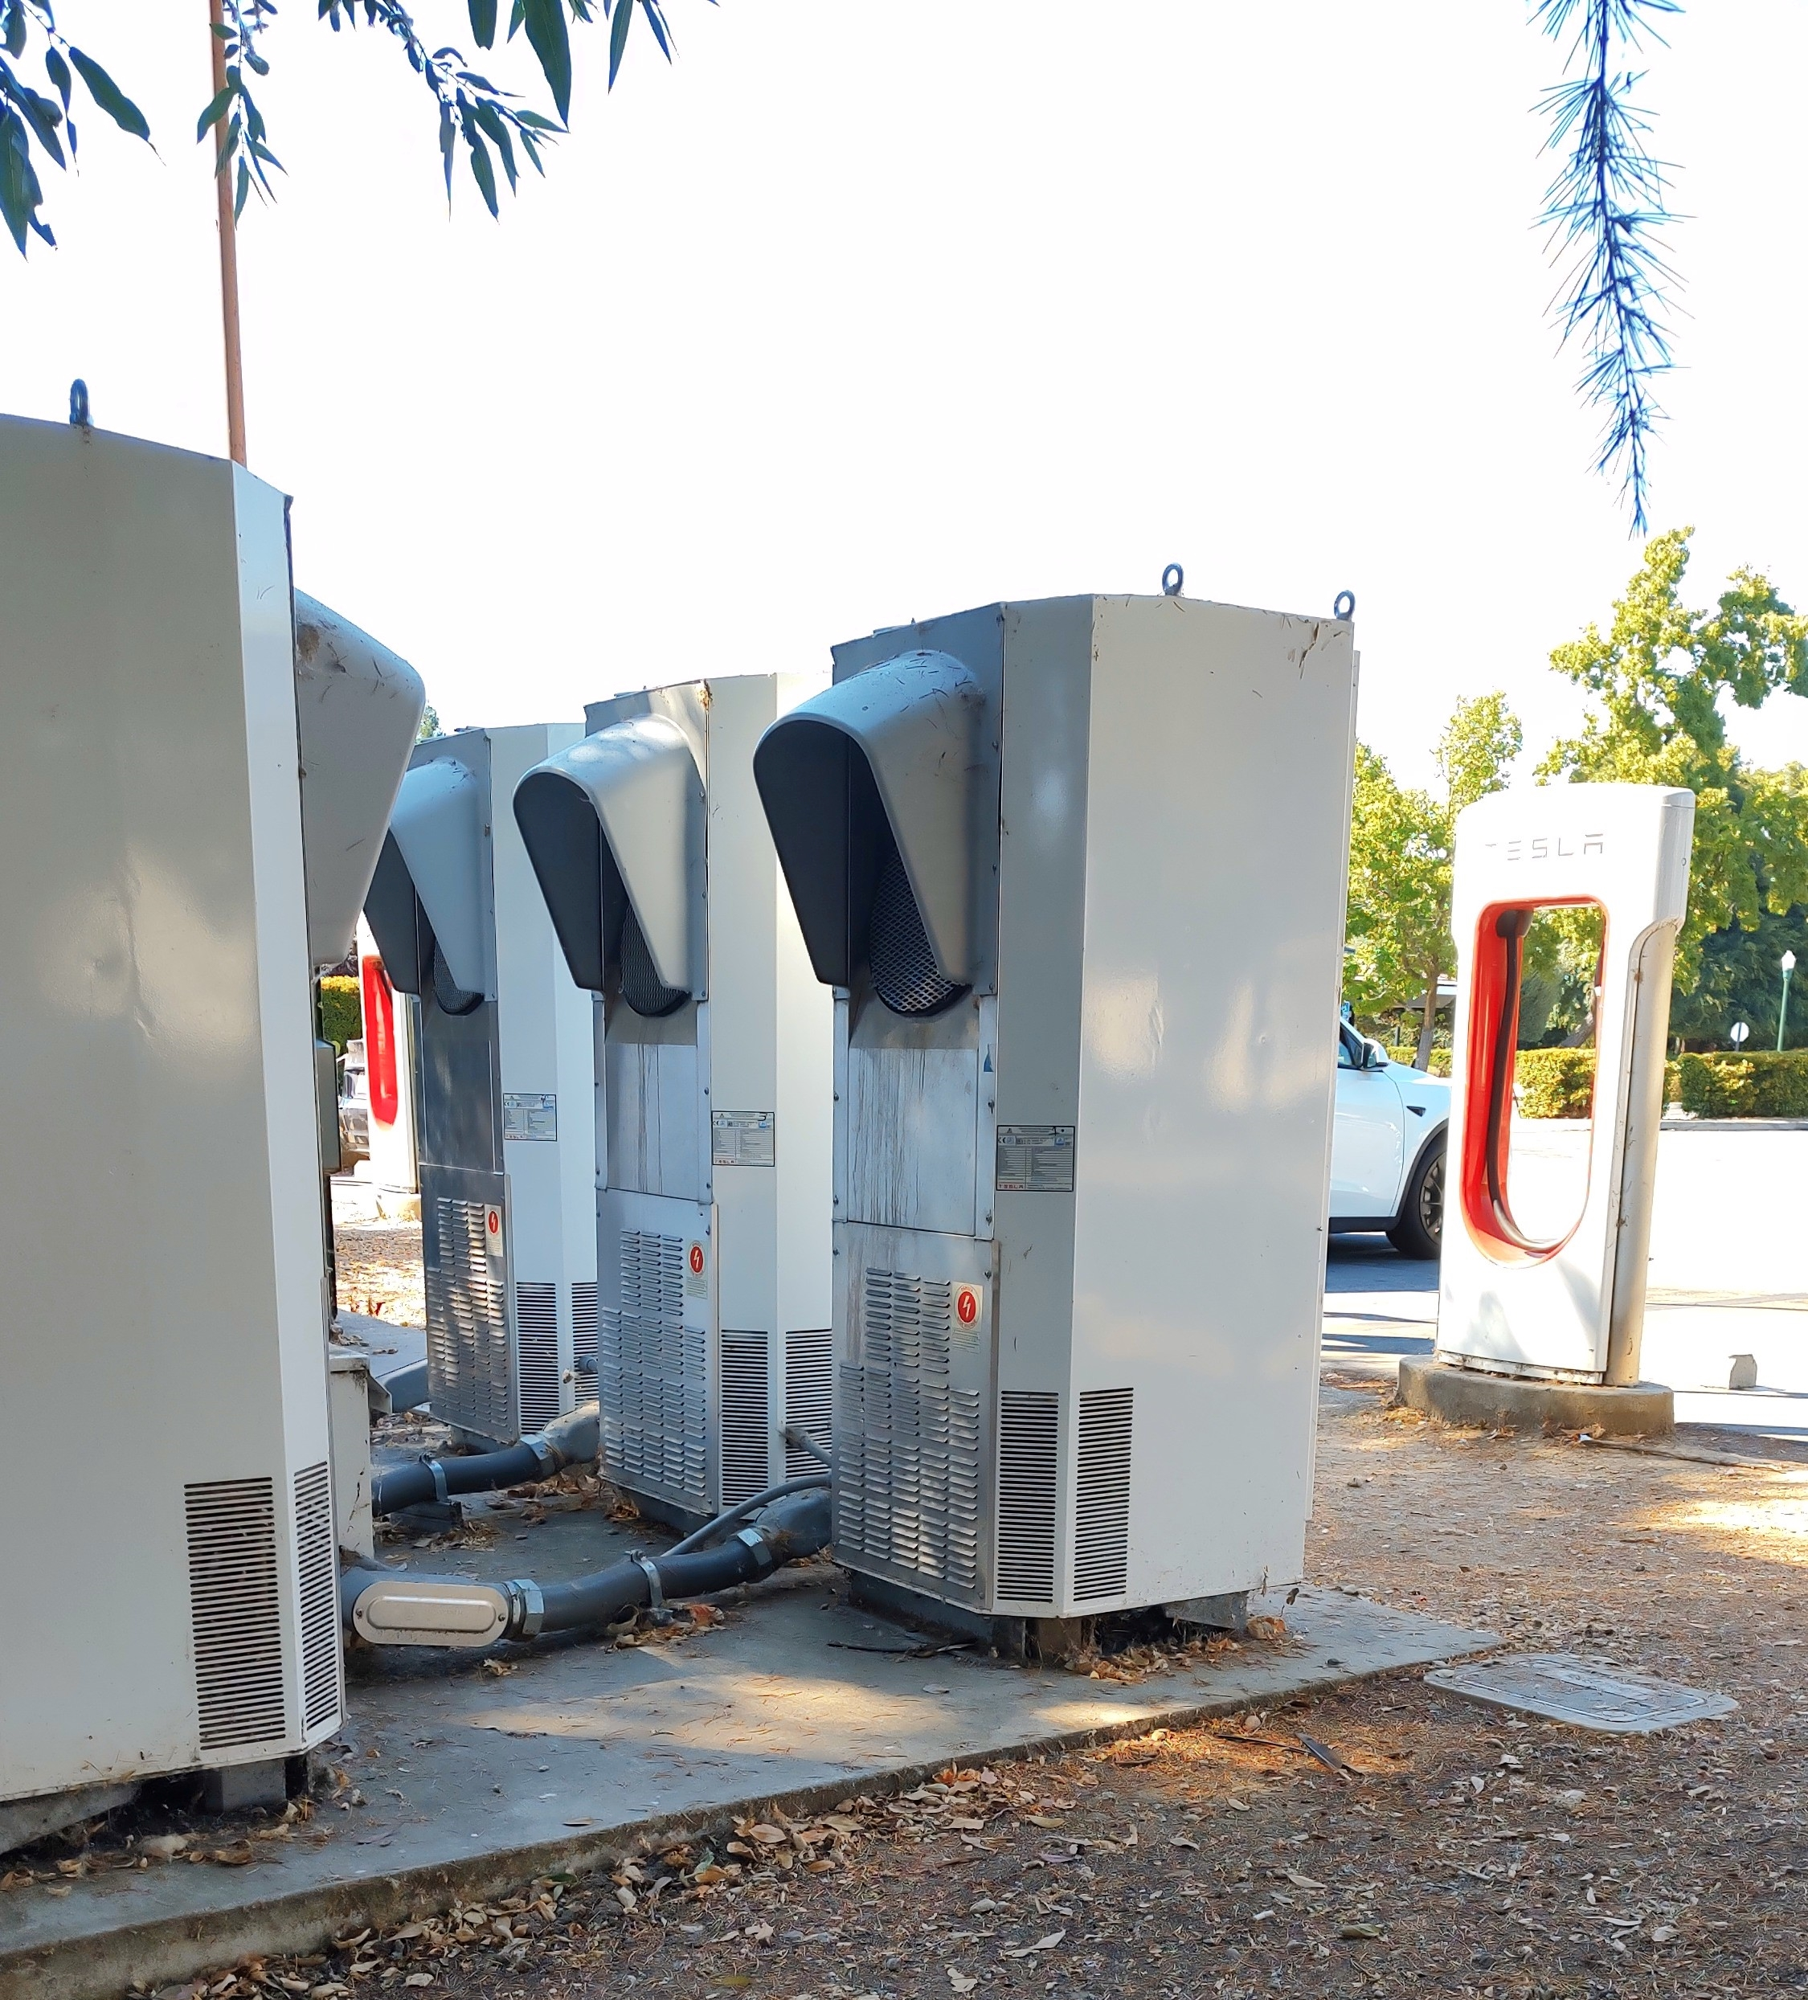
Transportation Electrification in California
Electric Vehicles – Fastest Growing Electrification Sector
7.5 million EV’s are expected on the road by 2030
Approx 1.2 million Public Charges will be needed
Bi-directional EV Charging may be part of the Energy Storage /Grid Stability Solution

Slide 31
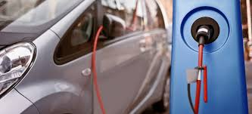
Electric Vehicle Charging in CALGreen
EV Readiness Definitions
Single Family
Multi Family
Non-Res
Medium- & Heavy-Duty Charging
Additions/Alterations
Notes:
Next we are going to move on to the Electric Vehicle Charging and Parking Requirements. In this new cycle of the code there has been a lot of upgrades, so we are going to cover how CALGreen defined EV Readiness, and then what the requirements are for SF, MF, NR, as well as this new heavy duty charging and the limited scope for A+A
.
Documents need to have calcs on the title sheet and locations on the site plans with details and labelling.
Conduit and panel space needs to be on the electric sheets.
Need to have the calcs on the title sheet, locations on the site plans with details and labeling and the conduit and panel space on the electrical sheets
To point out the language on the bottom of the slide- we’re talking about EV capable, so that means the raceway and conduit are installed but space does not have a charging station or outlet installed

Slide 32
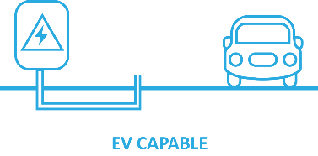
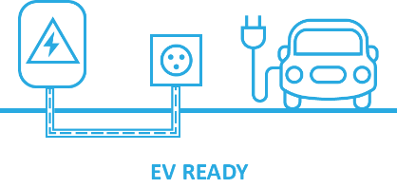
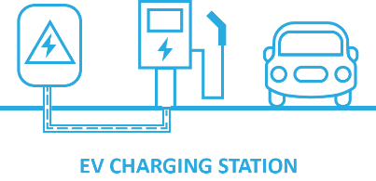
EV Readiness – 3 Types
Provide electrical panel space, conduit (no wire), and a termination box for a future 208/240--volt, 40-amp circuit
Provide a space that is fully wired for 208/240 volt and has a receptacle, and is “ready” for a Level 2 Charger
Provide Level 2 EVSE chargers. These should be stand-alone chargers in common-use parking areas
Notes:
California categorizes spaces into three types.

Slide 33
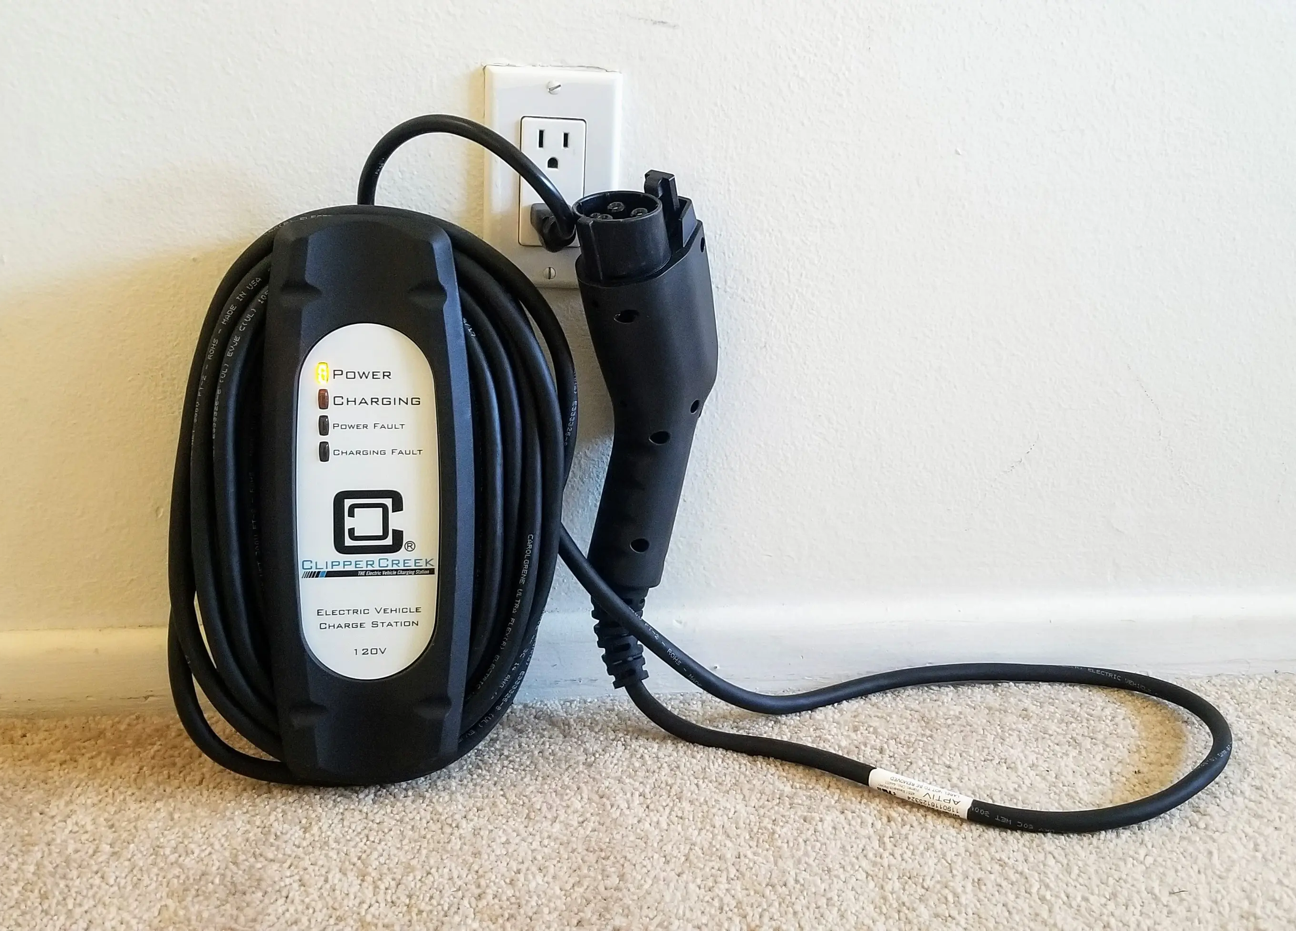
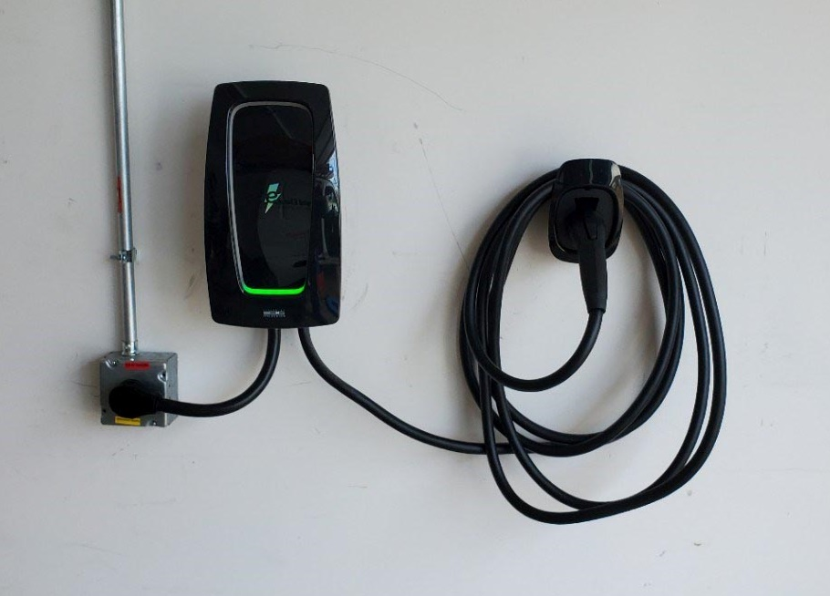
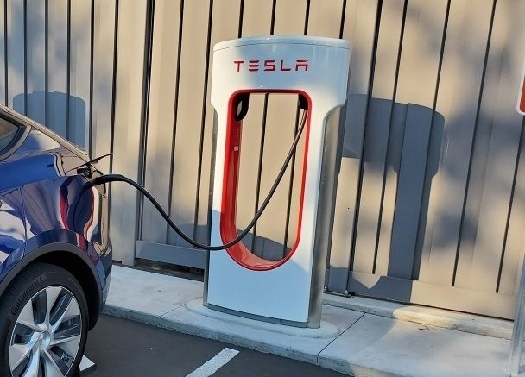
Types of Chargers
Level 1
120-volt, 16-amp commercial cable
Level 2
208/240-volt, 40-amp receptacle, or charge station
This is what is required of EVCS
Level 3 & DCFC (Direct current Fast Charger)
480-volt, 80-amp charging station
Allowed but not required by code
Notes:
In regards to spaces with charging capability, the code distinguishes between types of chargers.

Slide 34
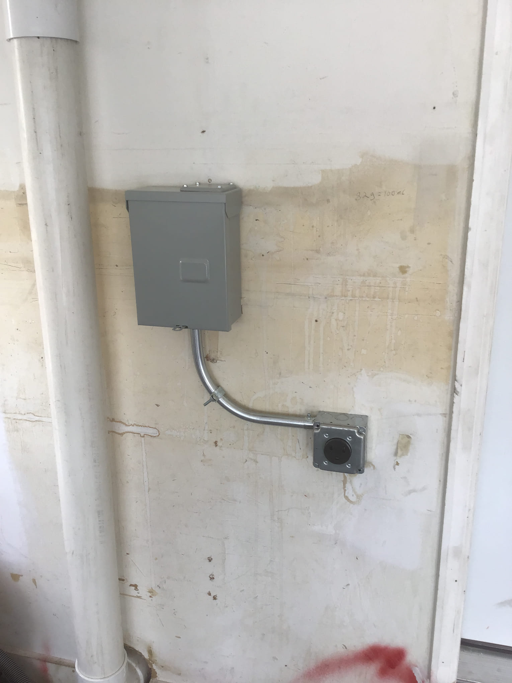
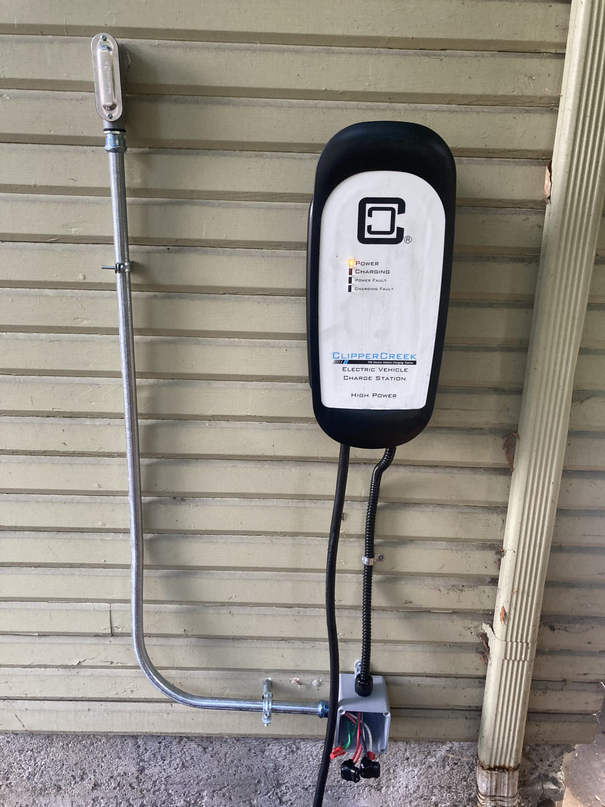
Electric Vehicle Charging- New Single Family
One- and two-family dwellings, townhouses with attached private garages
Requires EV Capable
Exception: Not required for ADUs/JADUs
4.106.4.1

Slide 35
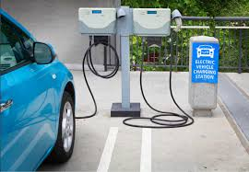
EV Charging - Multifamily & Hotel/Motels
Mid-2024 WAS:
EV Capable
  10% of total spaces
EV Ready
  25% of total spaces
As of July 1, 2024:
40% low power Level 2 EV charging receptacles!
10% Level 2 EV chargers
4.106.4.2 / 4.106.4.3
Notes:
L
10% of total parking spaces must be EV spaces for future EV supply equipment
When EV chargers installed, the space must be adjacent to an accessible space or on an accessible route
Documentation intended to demonstrate projects capability and capacity for future EV charging. EV spaces do not need to be available until EV chargers are installed for use.

Slide 36
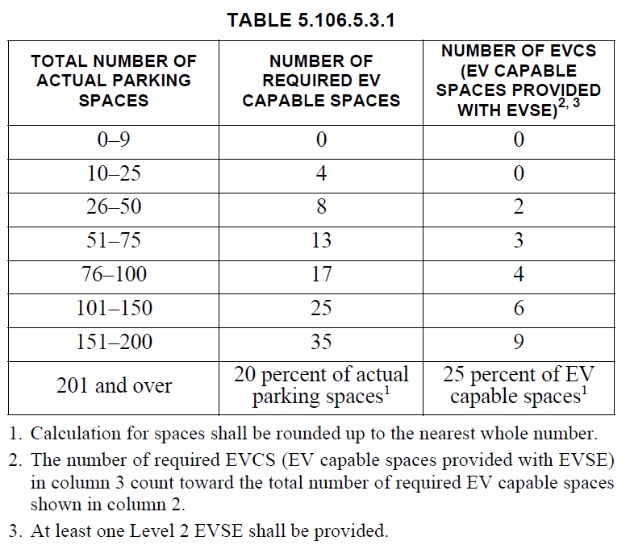
Electric Vehicle Charging - Non-Res
Based off this table
Note that the EVCS count towards the total number of EV Capable Spaces
Example:
  If a project has 28 parking spaces, 8 total EV spaces are required. 2 are EVCS and other 6 are EV Capable
5.106.5.3
Notes:
L
Installation for future EVSE

Slide 37
Alternative Approaches to EVCS
DC Fast Charger = 5 Level 2
Low-Power Level 2 =
½ regular Level 2
Power Allocation Method

Slide 38
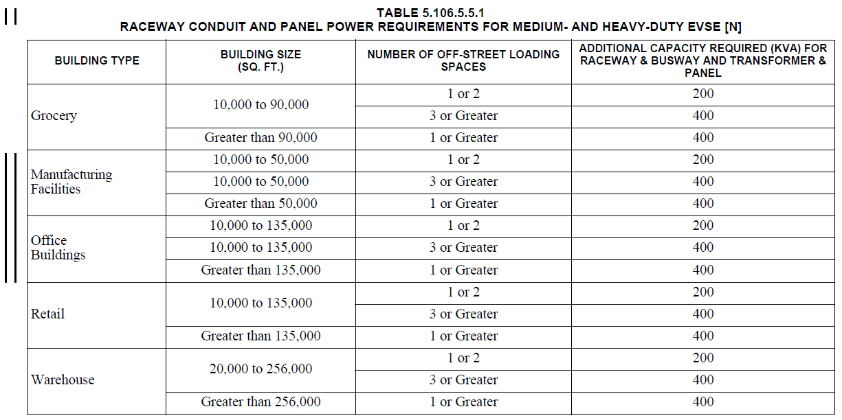

Medium- and Heavy-Duty Charging – and another thing…
5.106.5.3

Slide 39
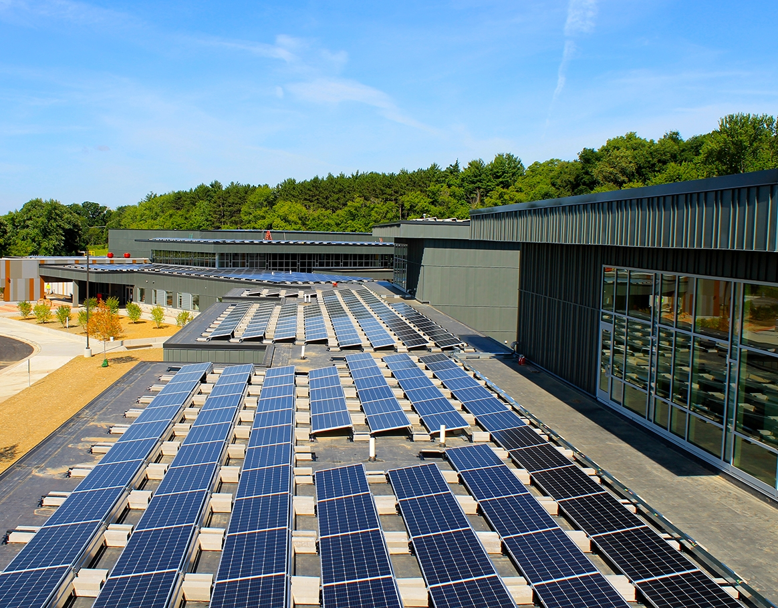
ZNCD Buildings
Forest Edge Elementary School, Fitchburg, WI

Slide 40
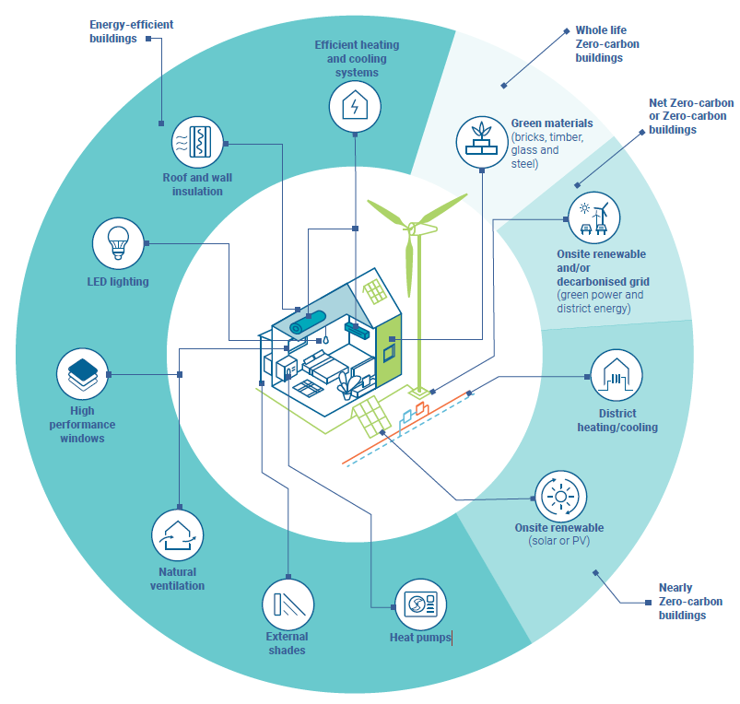
ZNC Buildings
Choose materials with low embodied carbon footprint
Supply Buildings with clean electric energy
  On-site solar, wind, micro-hydro, etc
  Decarbonized Grid
Design Energy Efficient Buildings
Use heat pumps –with low GWP refrigerants
  Space Conditioning
  Water Heating
  Appliances
Source: UN Environment Programme, “2022 Global Status Report for Buildings and Construction”

Slide 41
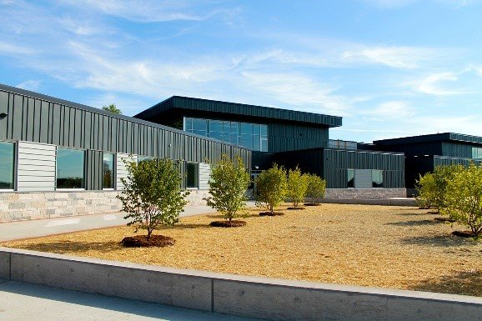
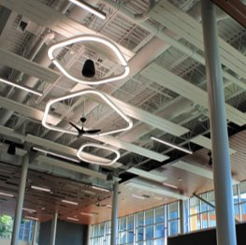
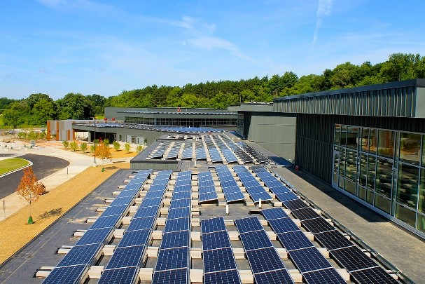
Forest Edge Elementary School –ASHRAE Technology Award 2024
Forest Edge Elementary School - Fitchburg, WI
Architect: Bray Architects, HGA
Builder: J.H. Findorff & Son
Largest net zero verified education project in the US
Project incorporates geothermal heating and cooling, rooftop photovoltaic (500 kW) and 125 kVA battery storage system (expandable to 500 kVA)
    Eliminates excess demand and provides power to the building during nighttime
    Excess energy: returned to grid/sold back to electric utility company
In one year, the solar panel system offsets CO2 emissions equivalent to: electrical usage of 96.4 homes, 1,403,553 miles driven, or 623,249 pounds of coal burned
https://www.msa-ps.com/our-experience/forest-edge-elementary-school/

Slide 42
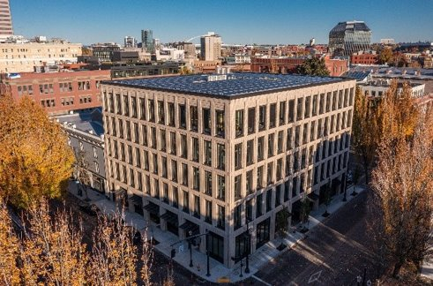
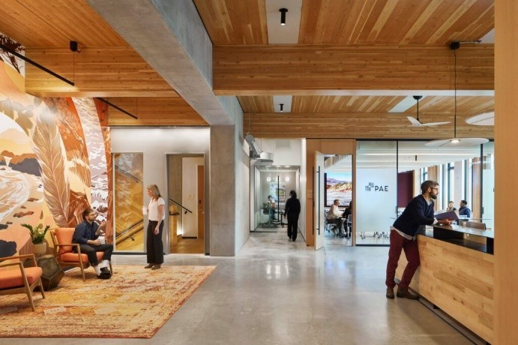
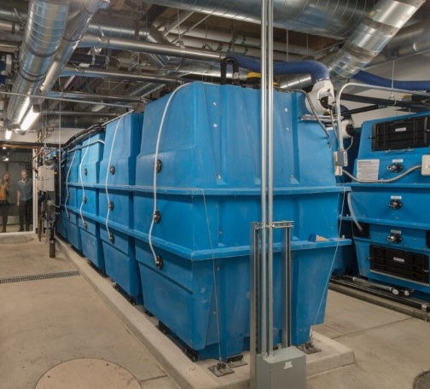
ILFI Full Living Building Certification –PAE Living Building
Owner: First and Pine LLC
Architect: ZGF Architects
Builder: PAE
5-story mixed use project incorporates both air-source and ground-source heat pump systems
Due to Historical District constraints, a 215 kW PV solar system is located on an affordable housing development a few miles down the road
  Project donated 60% of the PV system, while retaining the Renewable Energy Credits
Very low operating EUI: ∼16.1 kBtu/sf/yr
25% less embodied carbon than a comparable concrete and steel building
  The carbon footprint of construction was off-set with still purchased carbon credits
PAE Living Building - Portland, OR
https://living-future.org/case-studies/pae-living-building/

Slide 43
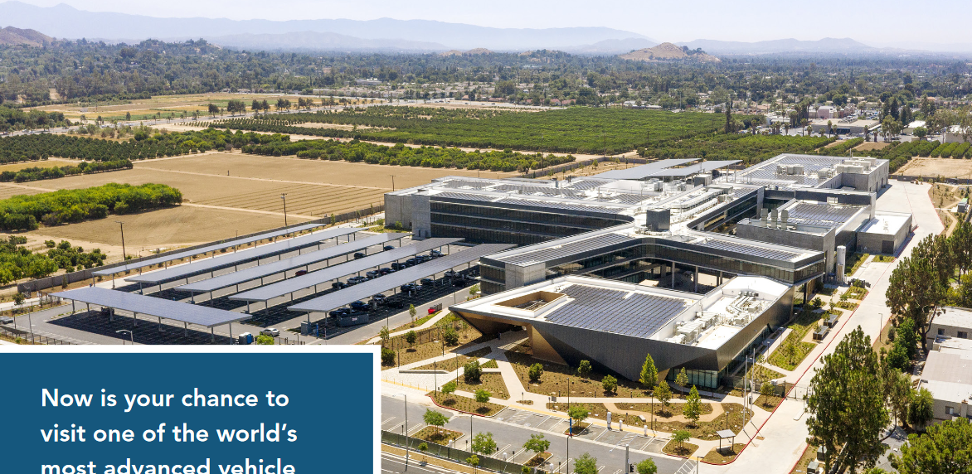
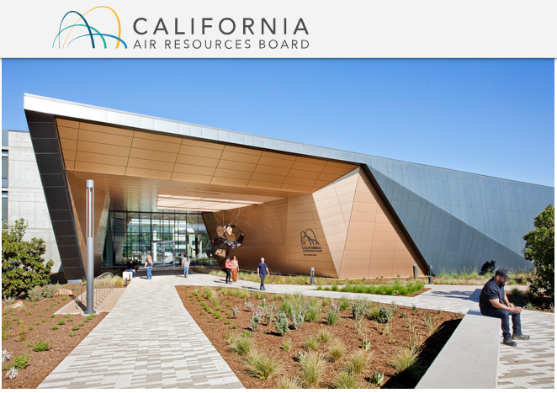
ZNE - California Air Resources Board –Leading by Example
Architect: ZGF Architects
Builder: Hensel Phelps
  Largest Zero Net Energy (ZNE) building(402,000 sf) in the United States – producing as much energy as it uses
  3500 kW Solar System –Estimated to produce 6,235,000 kWh/yr
  Leadership in Energy and Environmental Design (LEED) Platinum certification
  California Green Building Standards Code (CALGreen) Tier 2 standards
California Air Resources Board (CARB) - Mary D. Nichols Campus, Riverside, CA
https://ww2.arb.ca.gov/

Slide 44



ILFI Living Building –Gulf State Park Interpretive Center
Gulf State Park Interpretive Center - Gulf Shores, AL
Architect: ArchitectureWorks
Builder: Integral Group
  LEED Certified and engineered to reduce harmful emissions and contribute lowest environmental impact
  ILFI Net Positive Energy – Carbon Positive Building
    18.14 kW solar array
    13.5 kW battery system
  Saved approx. 41,840 lbs in CO2 emissions since solar panel installation (2018) –Equivalent to 316 trees planted
  Purchased verified Carbon Emission Reductions (CERs) to offset that embodied carbon of construction
https://living-future.org/case-studies/gulf-state-park-interpretive-center/

Slide 45
California Buildings: Pathway to Carbon Neutrality
1978
Title 24 Energy Standard
2008
Energy Efficiency Strategic Plan
2020
PV Requirement for Residential Construction
2030*
40% Reduction GHG in Buildings 60% Renewable Energy Generation
2045*
100%
Carbon-Free Electric Generation
Reminder:
Every 3 yrs, California Title 24 Building Codes are updated, furthering California’s Clean Energy and Zero Net Carbon Goals.
1970’s Energy Crisis
*Or sooner!
Notes:
Where we came from, where we’re going broad target wise.

Slide 46

Big Picture Goals for the 2022 Code (and 2025…)
  Encourage heat pump technology for space and water heating
  Establish electric-ready requirements for single family homes
  Expand PV systems and battery storage standards
Notes:
Encouraging electric heat pump technology for space and water heating, which consumes less energy and produces fewer emissions than gas-powered units.
Establishing electric-ready requirements for single-family homes to position owners to use cleaner electric heating, cooking and electric vehicle (EV) charging options whenever they choose to adopt those technologies.
Expanding solar photovoltaic (PV) system and battery storage standards to make clean energy available onsite and complement the state’s progress toward a 100 percent clean electricity grid.
Strengthening ventilation standards to improve indoor air quality.

Slide 47

All-Electric (and Nearly All-Electric) Buildings
New Construction All-Electric is relatively easy, with some exceptions for large scale buildings and industrial applications
Existing Buildings – Incremental opportunities for
  HVAC Replacement
  Appliance Replacement
  On-site Solar and Batteries
  Envelope Improvements
Existing Communities – Infrastructure Approach
  Decarbonize the Grid
  Reduce Natural Gas Carbon Footprint
Electric Variable Refrigerant Flow Heat Pumps
Solar Photovoltaic System
Morning Star Senior Living, San Jose, CA

Slide 48

Expected Benefits of California’s Climate Action Plan
How we design and construct our buildings will have a large impact on reducing GHG emissions and mitigating climate change
Not ‘tree-hugger’ fringe – it’s just how we build now

Slide 49



Questions about Title 24?
Energy Code Coaches are local experts who can help answer your Title 24 questions. Coaches have decades of experience in green building and energy efficiency improvements. They can provide citations and offer advice for your project to help your plans and forms earn approval the first time.
Online:
3c-ren.org/codes
Call:
805.781.1201

Slide 50
Closing
Continuing Education Units Available
  Contact itzel.ltorres@ventura.org for AIA
Coming to Your Inbox Soon!
  Slides, Recording, Survey – Please Take It and Help Us Out!
Upcoming Courses
  1/9: Heat Pumps for Heating & Cooling – Part 2: All-Electric Design & Construction
  1/16: Certified Passive House Designer/Consultant (CPHD) Pacific Winter Hybrid Cohort
  1/16: Domestic Hot Water – Part 3: All-Electric Design & Construction
  1/22: Introduction to the Energy Code
  1/23: Ventilation & HRV – Part 4: All-Electric Design & Construction
  1/30: Appliances & Energy Storage – Part 5: All-Electric Design & Construction Series
  2/6: Home Electrification Contractor Boot Camp
For more information about upcoming events please visit: https://www.3c-ren.org/events

Slide 51


Thank you!
For more info:
3c-ren.org
For questions:
info@3c-ren.org
Notes:
Thank you. You can learn more at 3C-REN.org or contact us at info@3C-REN.org.

